Slide 1


7B Unit1-2 Revision Dream homes& Neighbours

Slide 2

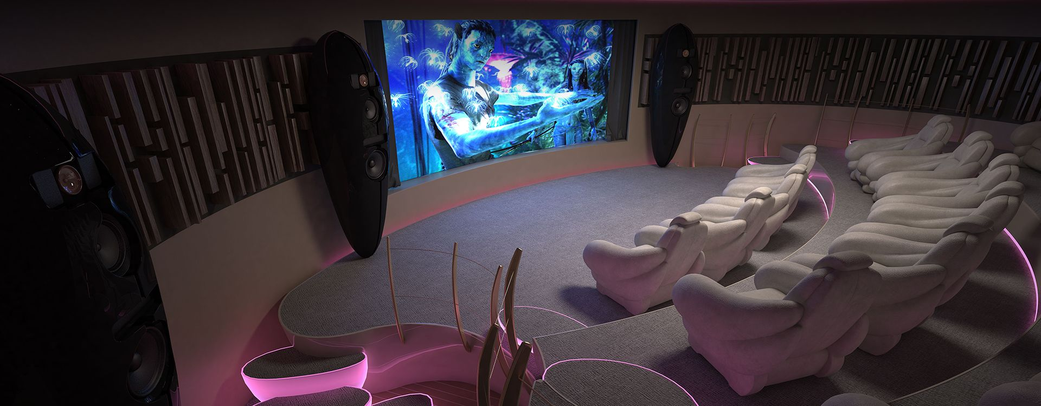
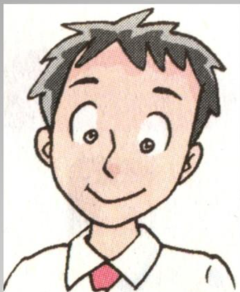
情景问答
Simon 喜欢看电影，梦想的家里有一个家庭影院。
Question1: What does Simon like?
Question2: What does Simon want in his dream home?
Simon likes watching films.
Simon wants to have a home cinema in his dream home.
a home cinema

Slide 3
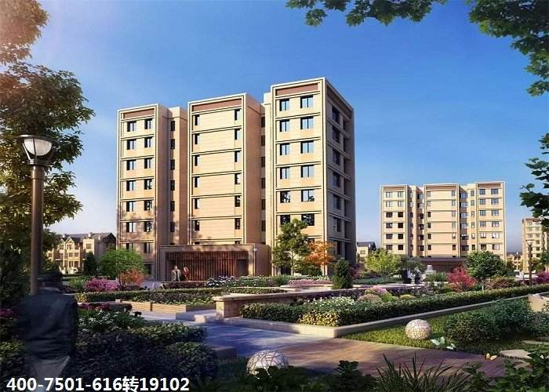
Simon’s home
Flat or house?

Slide 4
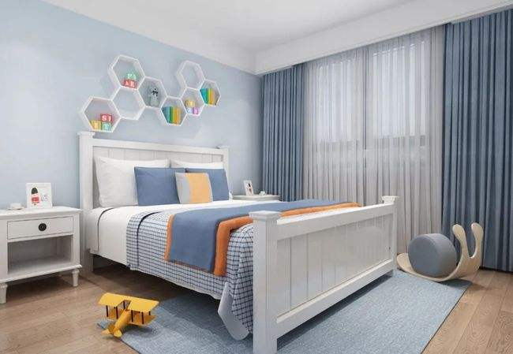
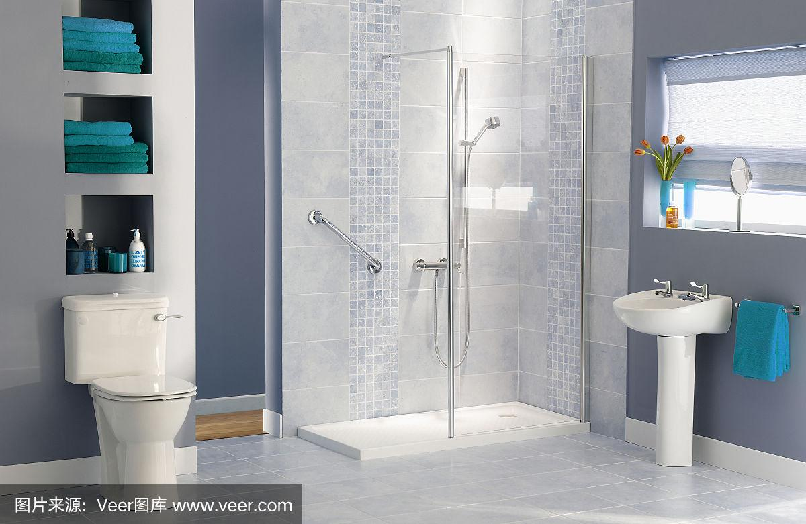
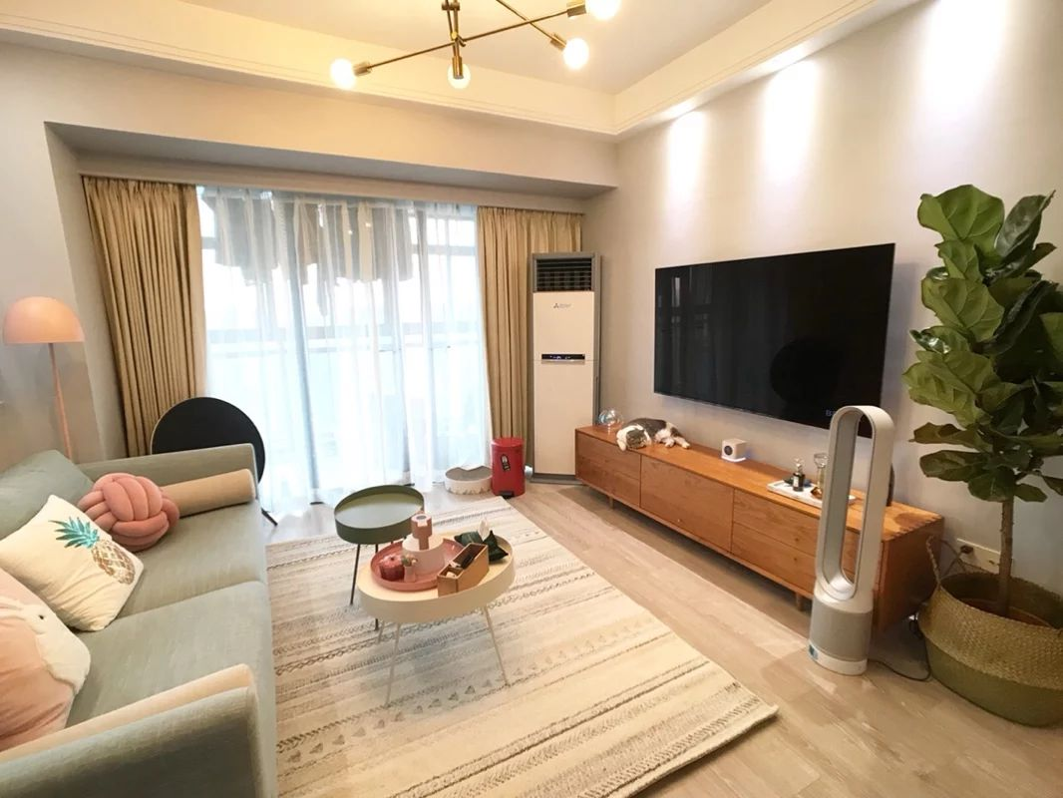
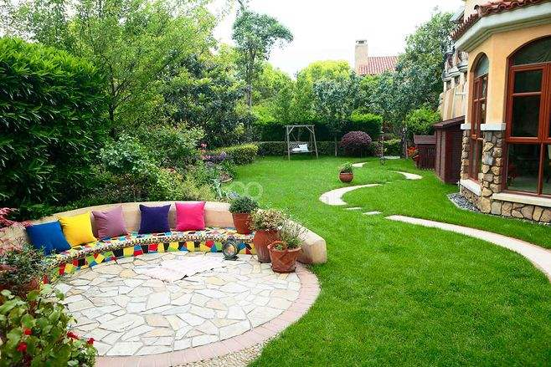
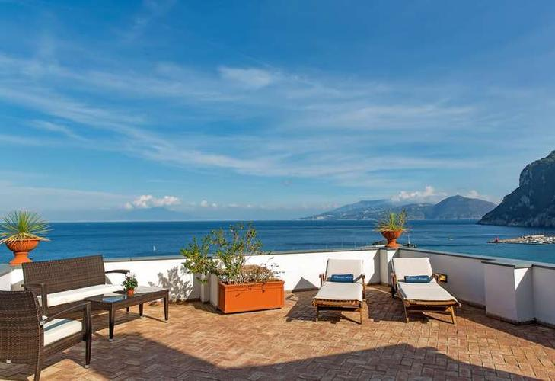
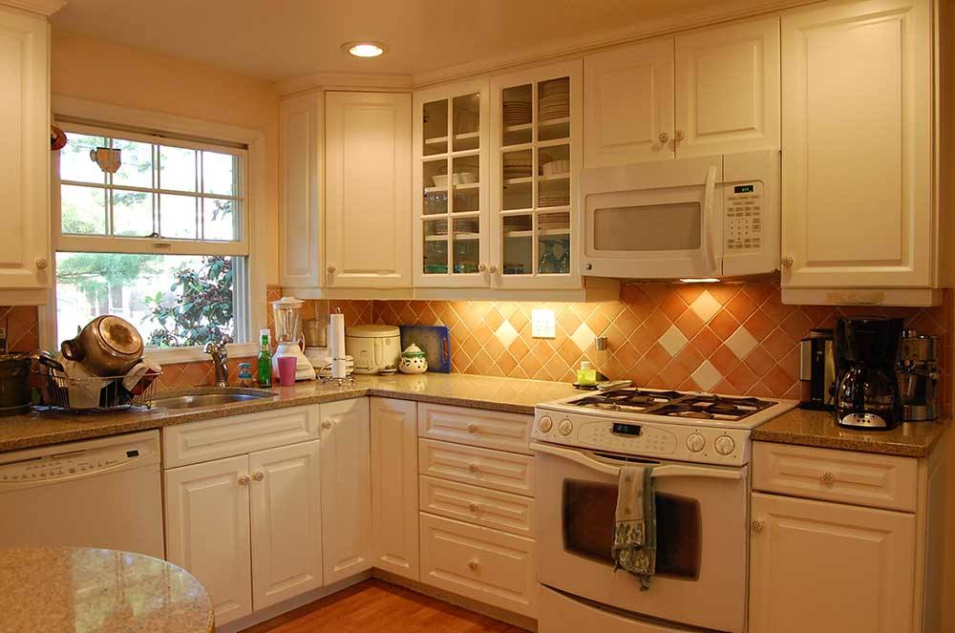
Rooms & Activities
What can you do in the room?
What rooms are there in a house?
bathroom
cook
garden
watch TV
wash the face
have a shower
living room
kitchen
water flowers
meet guests
do the dishes
balcony
look out at the sea
bedroom
Sleep and listen to music in bed

Slide 5
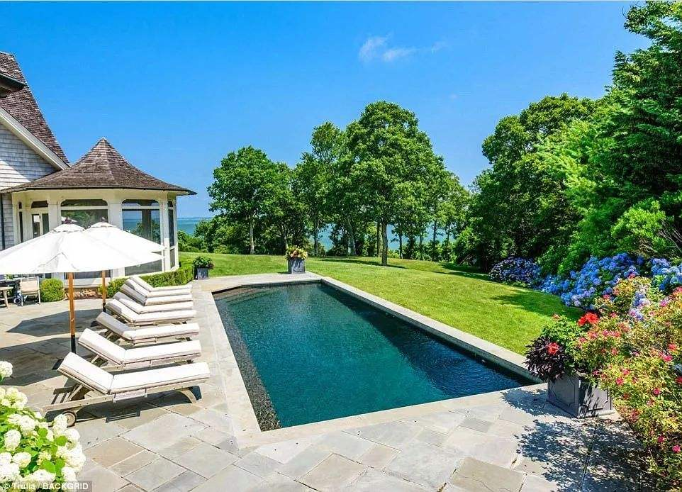
Simon’s Dream Home (口语朗读30)
My dream home is at the foot of a hill. It has three floors. There is a football field behind my house and a swimming pool beside it.
There is a kitchen and a home cinema on the ground floor. The kitchen is very clean. There is always more than enough food there. The cinema has a large TV. I would like to invite my frineds to watch films with me at the weekend.
On the first floor, there are six bedrooms. Each room has a new computer and all the beds are comfortable.
There are to large rooms on the second floor. My friends and I have parties there. It is great fun!

Slide 6

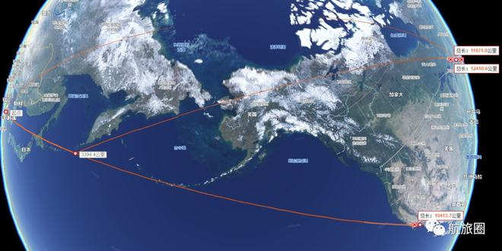
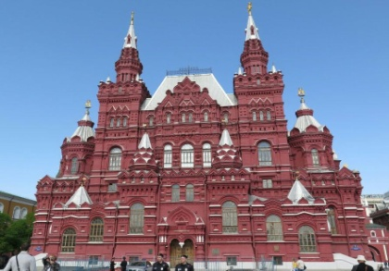


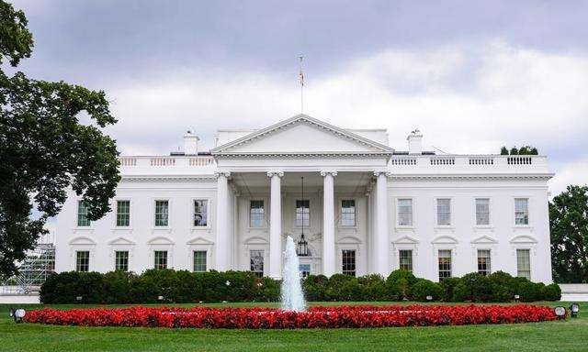
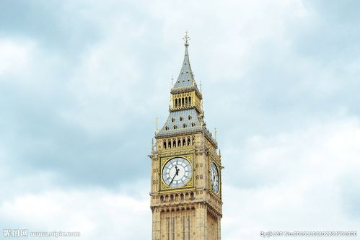
Countries & capitals
Red Square
Eiffel Tower
Russia
France
Moscow
Paris
CN Tower
the White House
Canada
Big Ben
the USA
Ottawa
the UK
Washington D.C.
London

Slide 7
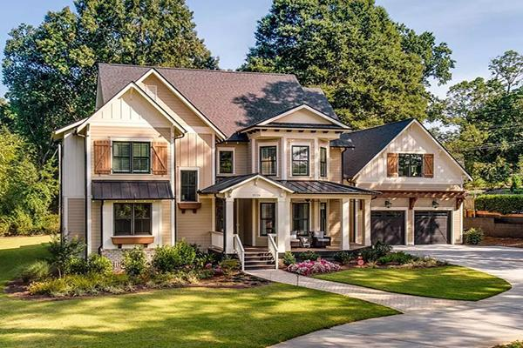
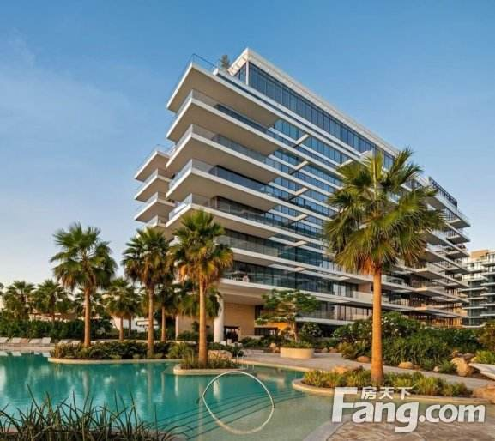
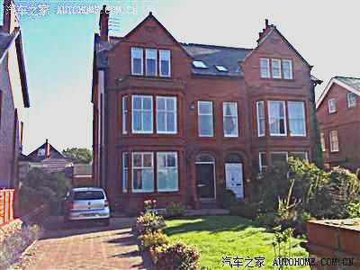
Which house do you like best?
It has 400 square meters in size/area.
This house is in an American style.
There are two floors.
______________(在一楼), there is a big__________(起居室), a _______(厨房), a _________(卫生间) and a beautiful _______(花园).there are hundreds of flowers in it.
________________(在二楼), there are four_________(卧室), a ______(书房), two big _________
(阳台) and three _________(卫生间).
The building is ___________
(在...中心) of the city.
The flat is ______________(在五楼). It is not very big, but it has a big living room and a _____________(游泳池). There are three bedrooms and two balconies.
We can _______________(向
外看见海) from the balcony and _______________(享用茶水) there.
The house locates in a town 15 ________(英里) from the city centre and _____________(有...面积) 400 square meters. It is ___________(在...脚下) a hill.
It has a lot of rooms and a big ________(停车场) on the first floor. So everyone can have a bedroom _________(属于
他自己的) and it has enough room for the cars.
in the centre
miles
On the first floor
on the fifth floor
has an area of
living room
kitchen
bathroom
at the foot of
garden
swimming pool
car park
On the second floor
look out at the sea
of his own
bedrooms
Everyone has his own bedroom.
study
balconies
enjoy a cup of tea
bathrooms

Slide 8
Cardinal numbers & ordinal numbers
Four hundred确定的数字(certain numbers)
1. The house has an area of 400 square metres.
2. The flat is on the fifth floor.
3. There are hundreds of flowers.
基数词(cardinal numbers)---the numbers of people or things
序数词(ordinal numbers)---- to order things and events
不确定的数字(uncertain numbers)
Tips:具体数字后,hundred,thousands,million,billion后不加s;不确定数字在固定搭配中，hundred等后加s再加of

Slide 9
直击中考
Simon is a young man in his ________(twenty). He is looking for a new home for his family. They like to take a walk after supper. So Simon wants a home with ___________(数百) trees around.
Next Friday, his family are going to celebrate his grandma’s ________(ninety) birthday. They have prepared ______(ninth) presents for her. So he needs large rooms.
twenties
hundreds of
ninetieth
nine

Slide 10




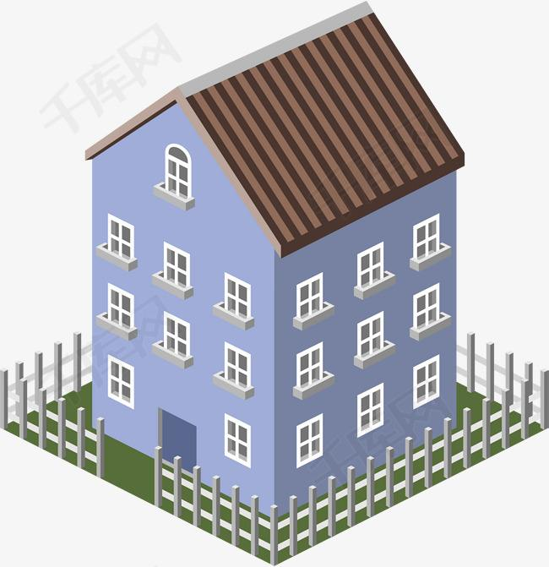
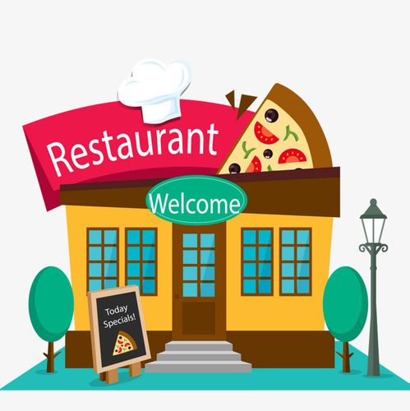
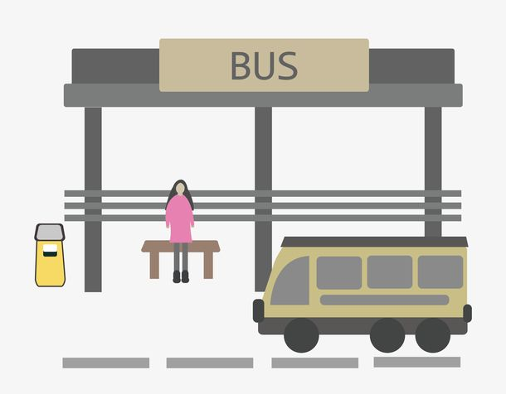
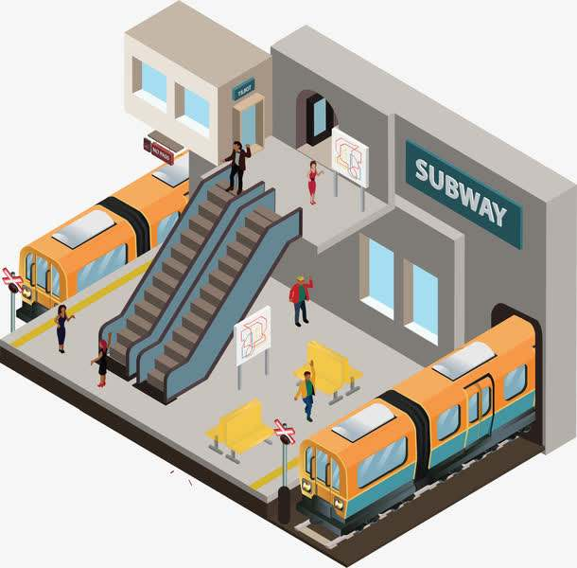
A good neighbourhood
It‘s lucky to live in a neighbourhood like that.
modern，beautiful and convenient(方便）

Slide 11




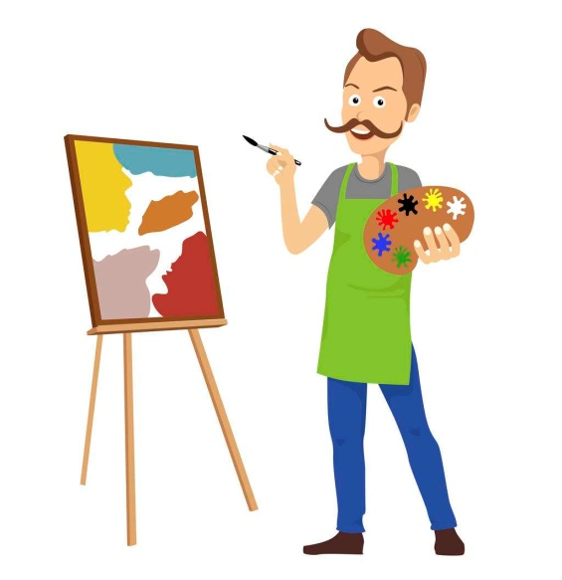
Neighbours & Jobs
college student
doctor
computer engineer
cook
artist
Simon’s neighbours
What are you going to be in the future?
Use “be going to …” to express your future plan
What does he/she do?/what is his/her job?what is he/she?

Slide 12
Neighbours&volunteers
Neighbours are dearer than distant relatives.
远亲不如近邻。
meet at the community centre
have a “helping hands” meeting
Neighbours
share their different skills
Volunteers
help neighbours with different kinds of problems

Slide 13
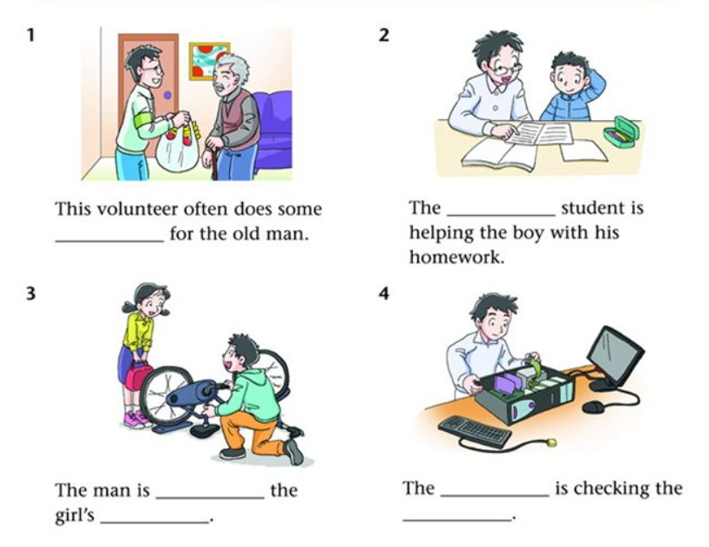
Neighbours&volunteers
Help each other
=someone’s bike is broken
If there is something wrong with someone’s bike or computer, volunteers will do some repair work for him.

Slide 14
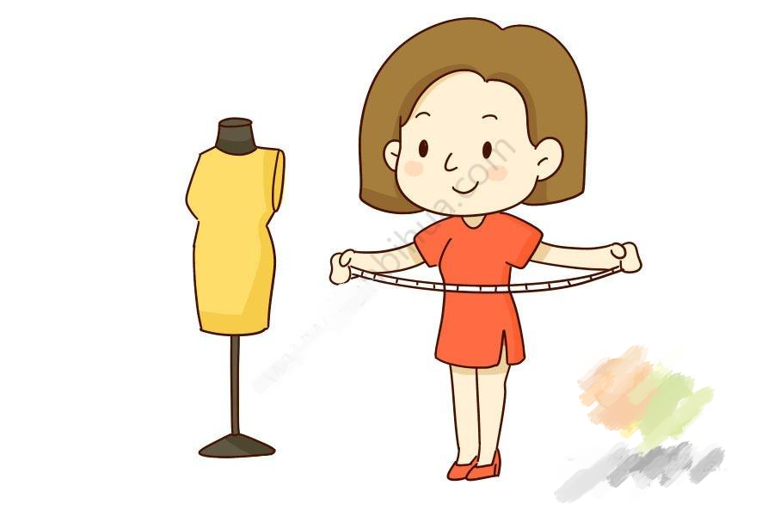
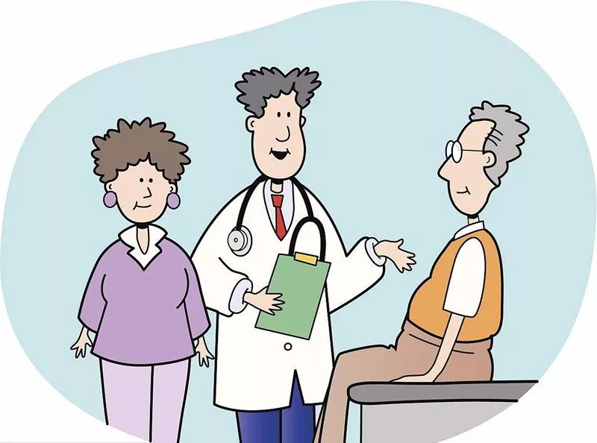

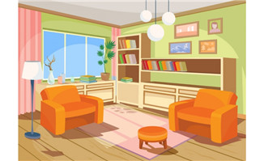
Neighbours&volunteers
Who can help them? What can they do ?
help sick people
give advice on how to keep healthy
give you ideas
the doctors and the nurses will give advice on how to keep healthy
If you are worrying about what to wear to your party or how to design your home,_________________________________________
When people do not feel well,__________________________
the artists will give you some ideas

Slide 15
Neighbours&volunteers
do some shopping
care for and help the old people
clean their flats
chat with them...
Volunteers can care for and help them
When the old people need some help,__________________________

Slide 16
A “helping hands” meeting
There ______(be) a “helping hands” meeting this Sunday afternoon. People ______(go) there if they need help with their problems.
Amy’s computer isn’t working. She __________________________(打算找人检查并修理它). Steven and Paul are both doctors. They __________________________(打算帮助生病的老人). If you want to know what to wear for a party or how to make your home beautiful, Carol and Austin _______________(会给你建议). They are artists. Bruce ________(come) back from the university that day. He ___________________________________(会帮孩子们解决数学问题). Simon with his friends Tommy, Cathy and Jessica ________(visit) Grandma Lee. They _______________________(打算帮助她做一些家务).
will be
will go
is going to find someone to fix it
are going to help sick old people
will give you ideas
will come
will help children with their maths problems
will visit
are going to help her do some housework

Slide 17
Simple future tense
will/ shall do
将来会发生的事或动作
Simple future tense
计划，打算
be going to do
actions that will
happen in the future
很有可能即将发生的事

Slide 18
话题14 邻居 Neighbours
1. 我的邻居们既善良又乐于助人。
他们有各种技能，经常帮助我们解决各种问题。
2. 你能找到电脑工程师修理电脑，
你也能找到人帮你修理坏了的自行车，
学生家庭作业上的问题也能得到帮助。
志愿者中还有一些大学生，
他们很乐意帮助别人。
3. 我们住在这样的社区真的很幸运。
My neighbours are kind and helpful.
They have different skills and often help us with all kinds of problems.
You can find computer engineers to fix the computer.
You can also find someone to fix things like broken bicycles.
Students can get help with their homework.
There are some college students among the volunteers,
and they are always ready to help.
We are very lucky to live in a neighbourhood like this.

Slide 19

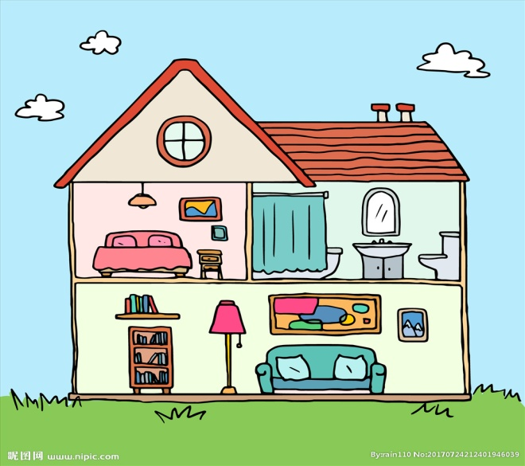
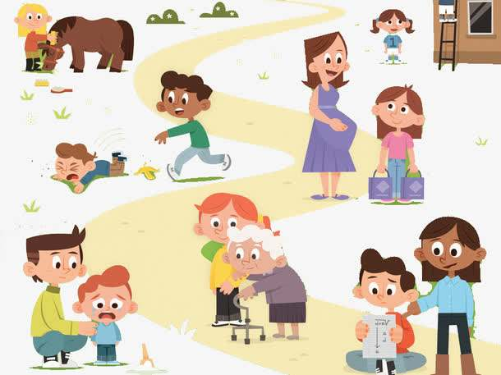
A good neighbourhood
A Dream Home
A dream house
Some kind neighbours

Slide 20
Writing
假如你是Lucy，你在学校英语论坛上看到下面题为“My dream home”的征文通知，请你根据通知，写一篇征文投稿。
Dear all,
Everyone has his or her dream home. Please share your idea with us!
What’s your dream home like?
What is your neighbourhood like?
What are your neighbours like?
How do you feel to live here?
Please write to us and share your dream home with us!
English Corner

Slide 21
Writing
My dream home
Para1 My dream home | Location( 位置）,flat or house floors, favourite room, activities ...
Para2 Neighbourhood | clean, modern, beautiful, convenient...
Para3 Neighbours | kind, helpful... (example)
Para4 Feelings | It’s lucky/ glad/good to...

Slide 22
Standars of evaluation(评分标准)
宾语从句
I think that …
If ….
When…..
Evaluation points | Standards | Full marks | Score
Content(内容) | Include all the points (包含所有要点) | 5 points
Language（语言） | Tense（时态正确） | 5 points
 | No grammatical mistakes （无语法错误）
 | No spelling mistakes （单词拼写正确)
Logical coherence (行文连贯) | Transitions（正确使用表示逻辑关系、连贯性的词或短语、复合句） | 3 points
 | Clear paragraphs and structure (分段，有清晰的结构)
Accuracy (词数、大小写、标点) | Punctruation&Number of words （标点正确，词数足够） | 1points
Handwriting(书写) | Beautiful and tidy handwriting (书写美观，卷面整洁) | 1points
连接词
Also
Not only...but...
Moreover What’s more However
as well as

Slide 23

Neighbours are dearer than distant relatives.
远亲不如近邻。
Having a good neighbour is being a good neighbour yourself.
拥有一个好邻居，自己先成为一个好邻居。

Slide 24

Homework
1.Make your writing perfect and share it with your friends.
2.Go over the two units and remember the key points.
3.Finish the exercises of unit1 & unit2 on the guidance book (中考指导书).

